Slide 1


Energy & Environmental Awareness Training 2025
Commitment & Continual Improvement For ISO 14001 & ISO 50001

Slide 2

2 Big Changes in the UK Energy Sector

Slide 3

Change No.1
The Regulated Asset Base (RAB) charge will be introduced from 1st November 2025. Initial rate: £3.455 per MWh (equivalent to approx. 0.35p per kWh).
PMS will pay circ. £2,500 per annum
How the Pass-Through Charge Works
RAB Model: This model allows consumers to contribute to the cost of a nuclear project while it is being built.
Payments: Electricity suppliers will collect these payments from consumers and pass them on to the project.
Timing: The charges will begin during the construction phase of a nuclear project, not just once the plant is operational.
Purpose: By providing upfront financing, the RAB model lowers the risk for private investors, reducing the cost of capital and ultimately leading to expected savings for consumers over the project’s lifetime.
This Photo by Unknown Author is licensed under CC BY-NC

Slide 4
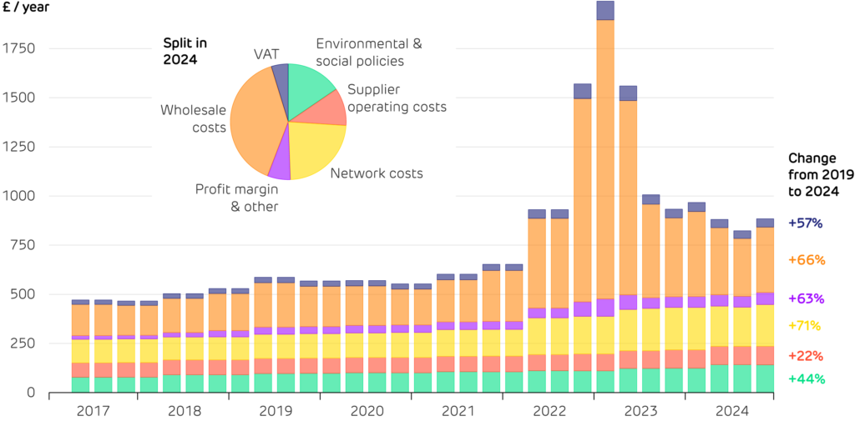
Change No.2
Unit Rate Breakdown…..

Slide 5
Pass Through Charges are Increasing
Infrastructure and Network Costs: Upgrades and maintenance of the energy networks (transmission and distribution) lead to higher charges.
Renewable Energy Schemes: The cost of supporting renewable energy sources, like the Contracts for Difference (CfD) scheme, is ultimately covered by consumers through their energy bills.
Increased Visibility: Suppliers are changing how they present bills, making these previously hidden costs more apparent to consumers and businesses.

Slide 6

Refresher
Carbon Reporting…
Standard Units of Measurement for Electricity and Gas are KWh –
Kilowatt Hours
1 Electricity kWh = 0.20705 kg CO2e
1 Gas kWh = 0.20264 kg CO2e
Companies Report Footprints in Tons CO2e
Must record anything imported from the grid Absolute Carbon Footprint.
Only way to truly claim Zero Carbon is to generate your own power.
What is “Net Zero” – preventing the addition of any more carbon to the atmosphere from an agreed baseline

Slide 7

PMS Baseline Year (FY 2019-20)….
1,079 tons CO2e
(Intensity Ratio)

Slide 8

Breakdown of Scopes by CO2e – Latest FY
Scope 1 – 827 tons CO2e
Fleet transport is the highest carbon emitter!
Scope 2 – 142 tons CO2e
Electricity emissions have fallen by more than 30% from 2019.
Scope 3 – 4.5 tons CO2e
Transport expense claims are minimal!
Chosen to exclude Travel (for now).

Slide 9


Slide 10
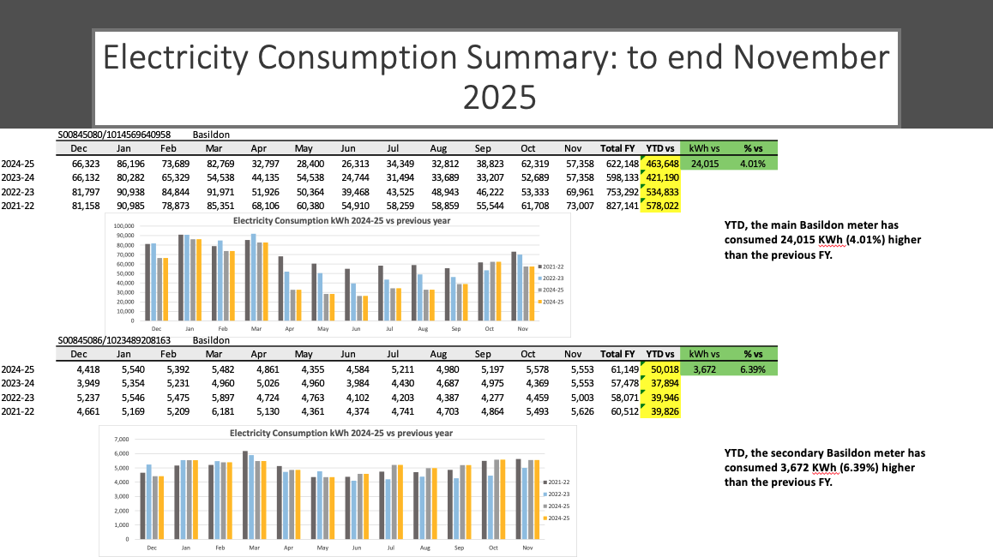

Slide 11
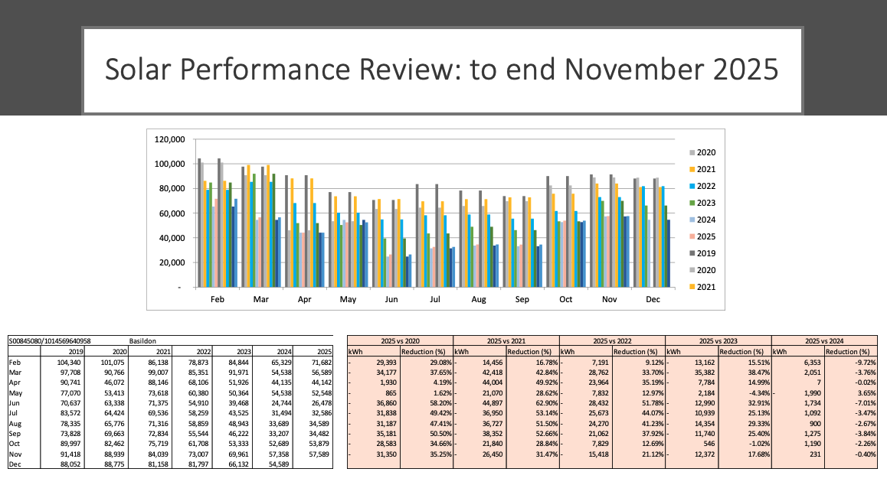
Solar Installed
November 2021

Slide 12

Questions

